Slide 1

Software Development Process
Using Agile

Slide 2

Roles

Slide 3
Scrum Master
Implements the Scum Process and ensures it is understood and enacted
Is a servant leader for the Scrum Team
Oraganizes / facilitates Scrum Events for the Development Team
Ensures development team is self-organizing
Removes impediments to the Development Team’s progress

Slide 4
Product Owner
Responsible for maximizing value of product and the work of Development Team
Sole person responsible for managing Product Backlog
Represents the Business Sponsor
Decision maker for the project
Ensures backlog is transparent, understandable for all parties and shows what the Scrum Team will work on next

Slide 5
Tester
Works with Product Owner to ensure product meets customer requirements
Ensures tests are clear, understandable and thorough
Provides feedback to Development Team
Tests Validity of the product

Slide 6
Development Team
Self Organizing
Cross-functional with skills to complete project
Provides feedback to Development Team
No individual recognition of members. The team is one entity
Accountable for delivering results they committed to

Slide 7
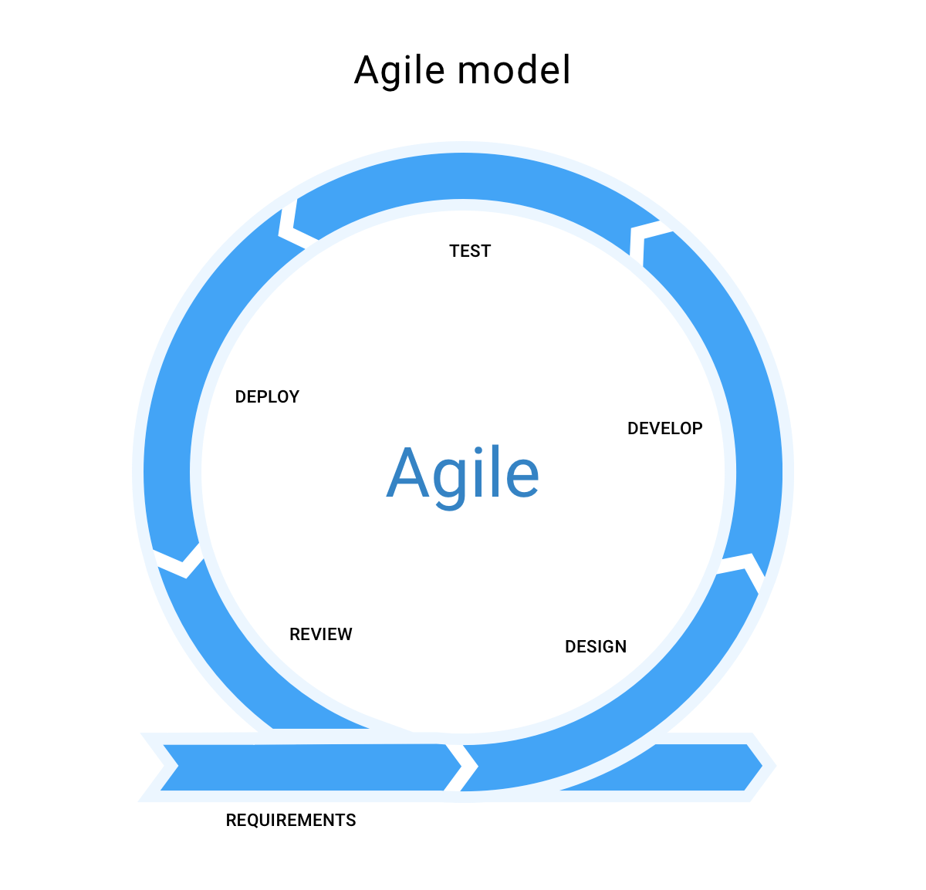
SDLC Phases: Agile Approach

Slide 8
Gathering input from Customer by the Product Owner
Gains understanding of what customer wants
Helps Product Owner envision how to write User Stories
Sprint Planning Meeting
Rolling wave planning
Develop high level plan to define vision, scope and whatever is necessary to planning and estimation
Details of plan further elaborated as project progresses.
Product Backlog
Sprint
1-4 weeks in length (2 is typical length)
Daily Scrums (Standups)
Sprint Reviews
Start process over
Delivery of Finished Product

Slide 9

SDLC Phases:
Waterfall Approach

Slide 10
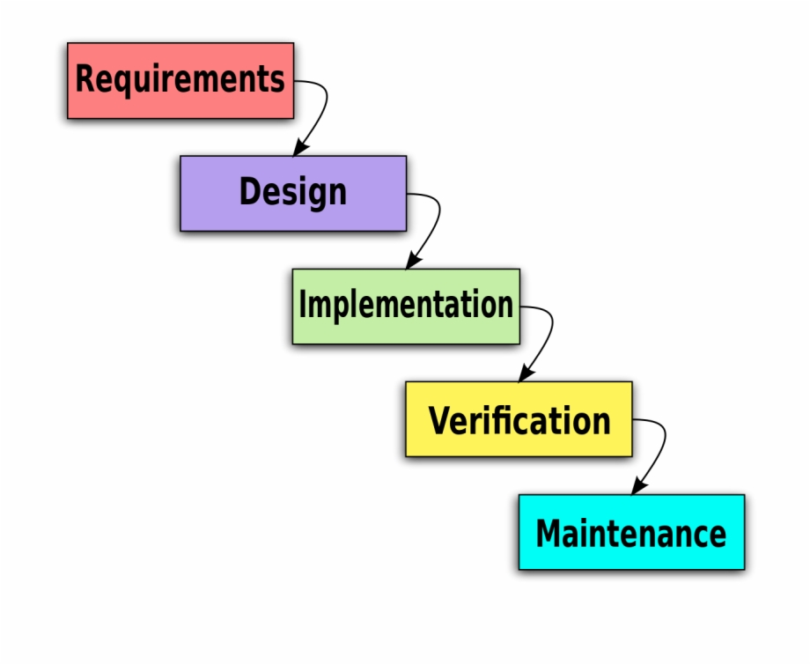
Waterfall Phases
Sequential
No steps is started until the previous is completed
Forward motion drives SDLC to the next step. Not adaptive
Issues arise in later phases can cause a complete breakdown of requirements. Error can happen very early and not detected until later stages
Testing comes after development
SNHU Travel change late in production would have halted project completely. Multiple steps would have to be re-done and start from beginning.

Slide 11
Agile vs Waterfall
Agile
Done in Iterative, small chunks
More Concurrent and adaptive in approach
Testing done throughout iterations
Detect issues / failed requirements during iteration
Customer focused, by involving throughout development.
Can be manipulated / changed throughout entire SDLC
Waterfall
Sequential
Plan Driven (plan entire project first)
Testing done at end, after development
Issue found in final stage can reveal it was made multiple steps prior. Can disrupt entire plan and cause work to be halted and even re-started from beginning
Execution of steps to move on to next
Focused on sticking to plan initialized in beginning. Not adaptive.

Slide 12
Agile or Waterfall? Factors to Consider
Agile
Customer focused, drives entire process
Small, self-organizing teams
Done in small chunks, or increments.
Adaptable to changes throughout project
Testing / release done in sprints to allow customer to see progress / functionality throughout development.
Waterfall
One of Earliest Development Methods
Proven to have success in the past
Focused on releasing fully developed product
Sequential
Testing after development of product

Slide 13
Works Cited
Cobb, C. G. (2015). The Project Manager's Guide to Mastering Agile: Principles and practices for an adaptive approach. John Wiley & Sons.
Lankford, T. (2020, June 17). If Your Scrum Is Not Fun, You Are Doing It Wrong. Serious Scrum. https://medium.com/serious-scrum/if-your-scrum-is-not-fun-you-might-be-doing-it-wrong-6c5fbce6bf48
‌
Manifesto for Agile Software Development. (2001). Agilemanifesto.org. https://agilemanifesto.org/
Westland, J. (2018, January 11). Quick Guide to Scrum Methodology. ProjectManager.Com. https://www.projectmanager.com/blog/scrum-methodology
What is Scrum? (2010). Scrum.Org. https://www.scrum.org/resources/what-is-scrum/

